Slide 1

Bachelor of Technology
(Computer Science and Engineering) Submitted to
LOVELY PROFESSIONAL UNIVERSITY PHAGWARA, PUNJAB
FINAL PRESENTATION REPORT ON Food Delivery App for LPU Campus
NAME :- Vivek Kumar ROLL NO. :- 11
REG NO. :- 12211884
SECTION :- RK0105
SUBMITTED TO :- Lovely Professional University

Slide 2
INTRODUCTION
For my final-semester project at Lovely Professional University (LPU), I, Alok Kumar (Roll No: 47, Reg No: 12207821), developed a Food Delivery App to enhance the delivery experience within the LPU campus. The app addresses key issues such as:
Complex navigation in existing platforms.
Lack of hostel door-to-door delivery.
Unclear order tracking and limited personalization.
Using UI/UX principles like User Flow Diagrams and Information Architecture, I focused on creating a user-friendly and efficient platform.
Low-Fidelity Wireframes:
Simplified navigation for hostel delivery.
Quick food selection and tracking.
High-Fidelity Wireframes:
Polished designs with real-time tracking.
Customizable filters and mobile-friendly layouts.

Slide 3
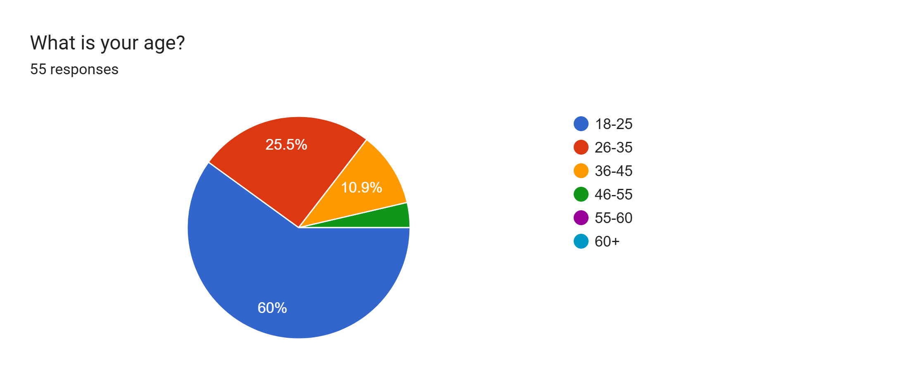
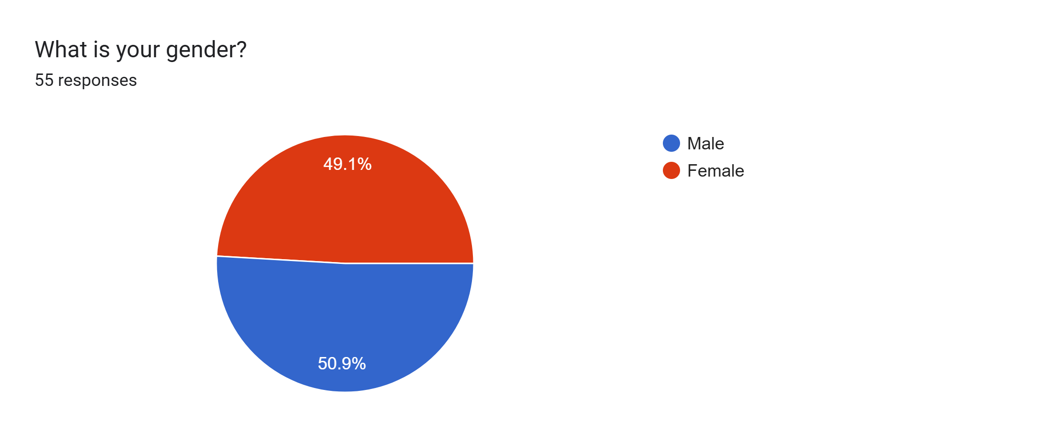
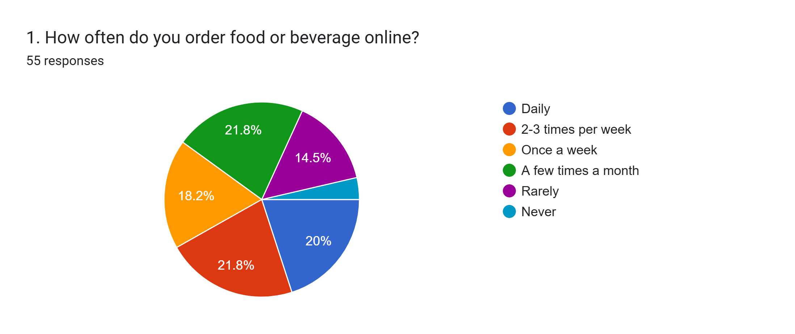
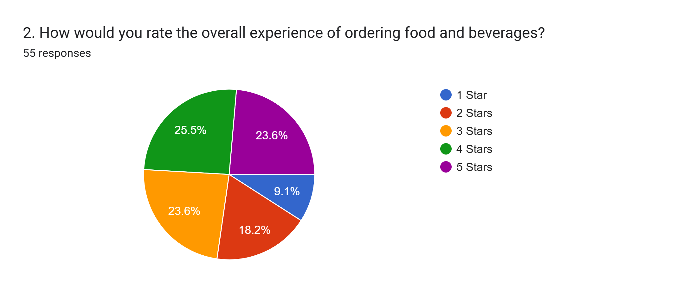

Slide 4
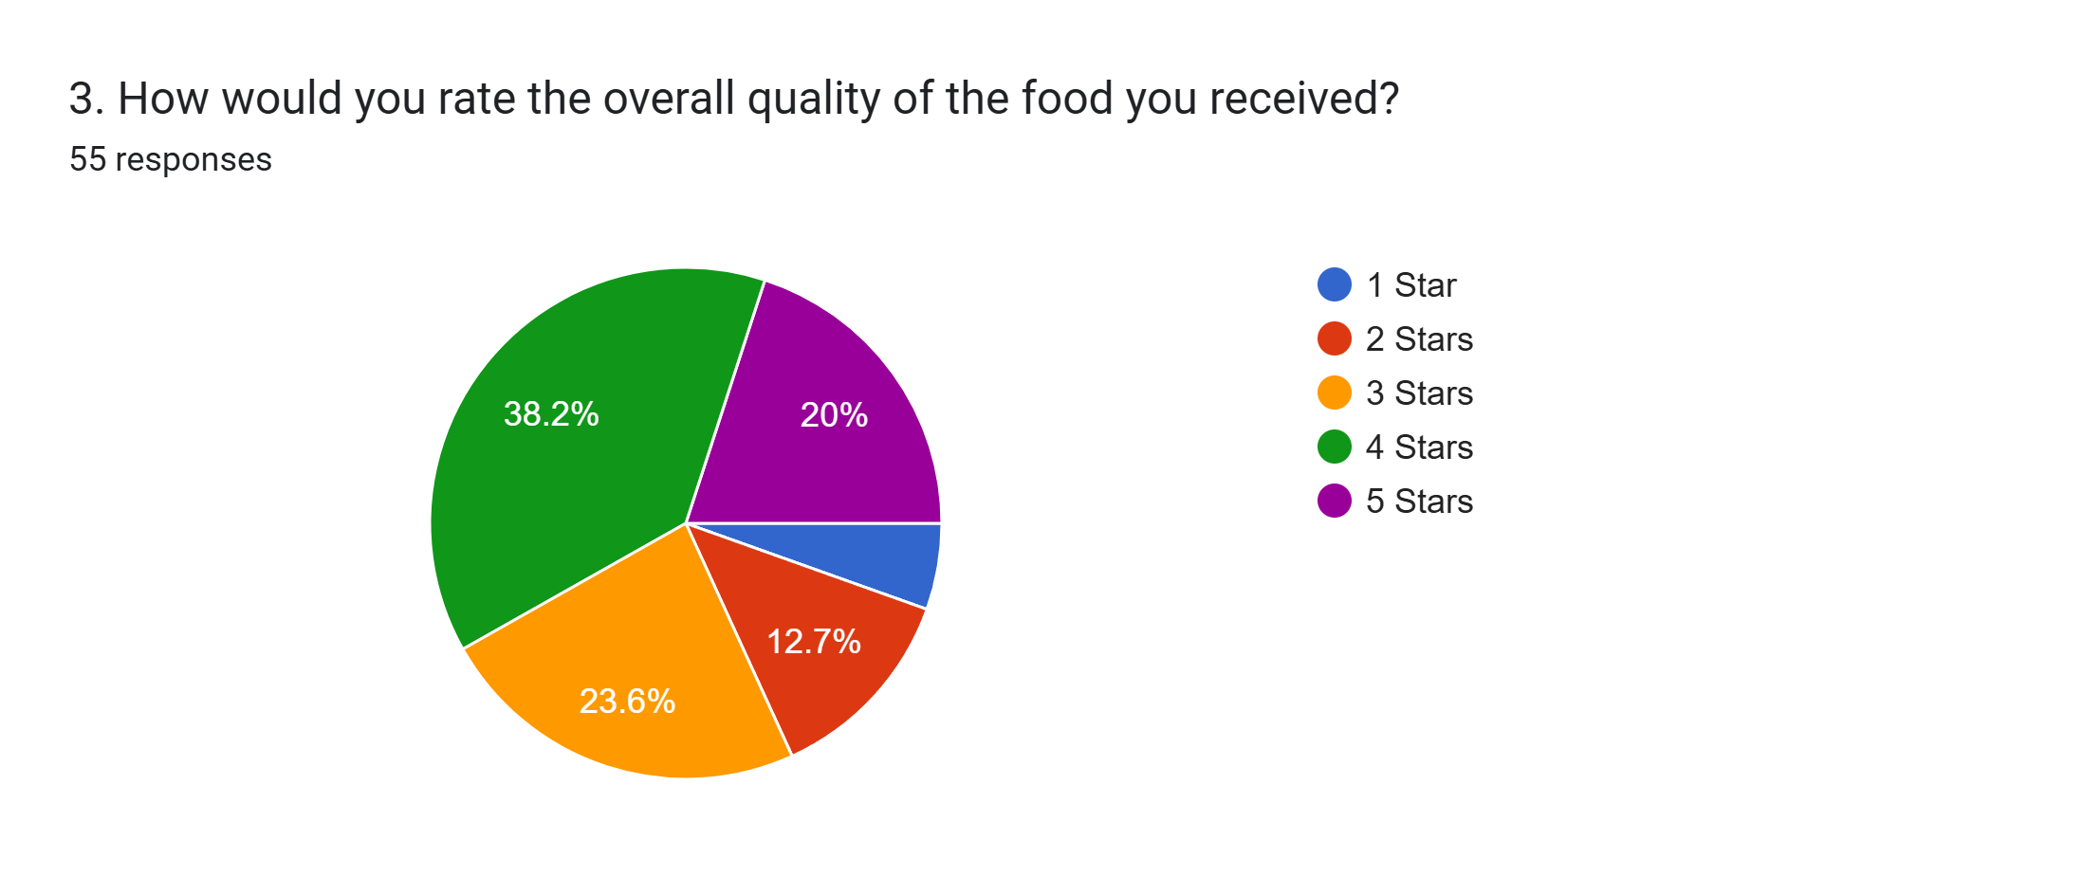
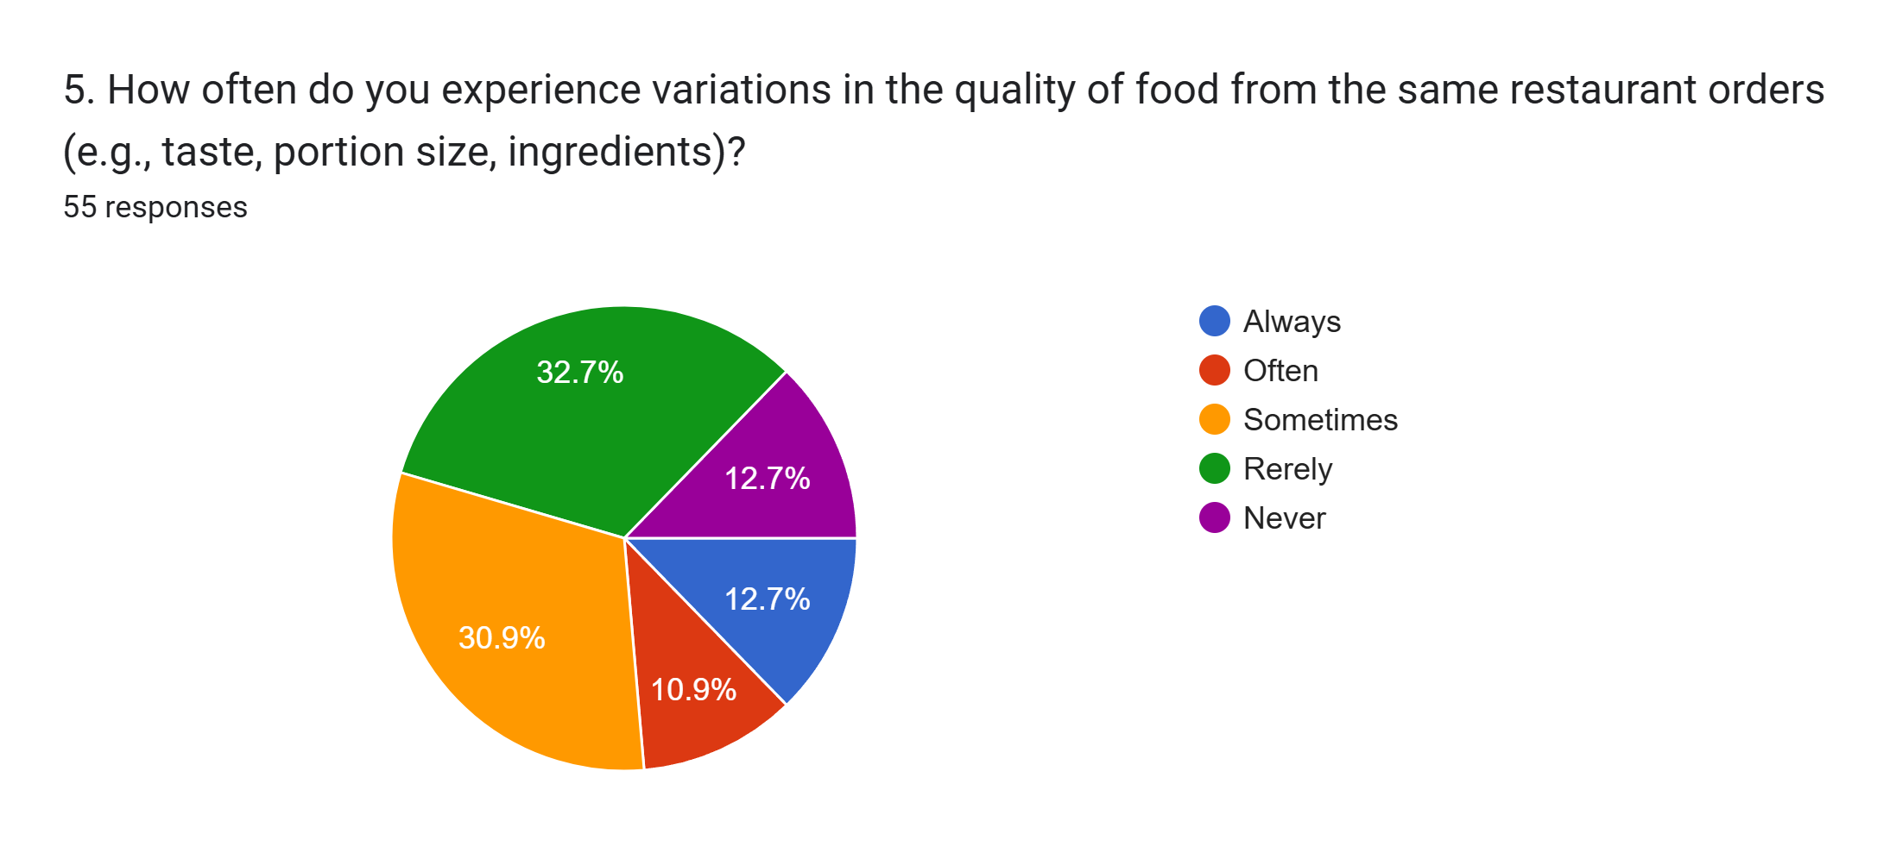
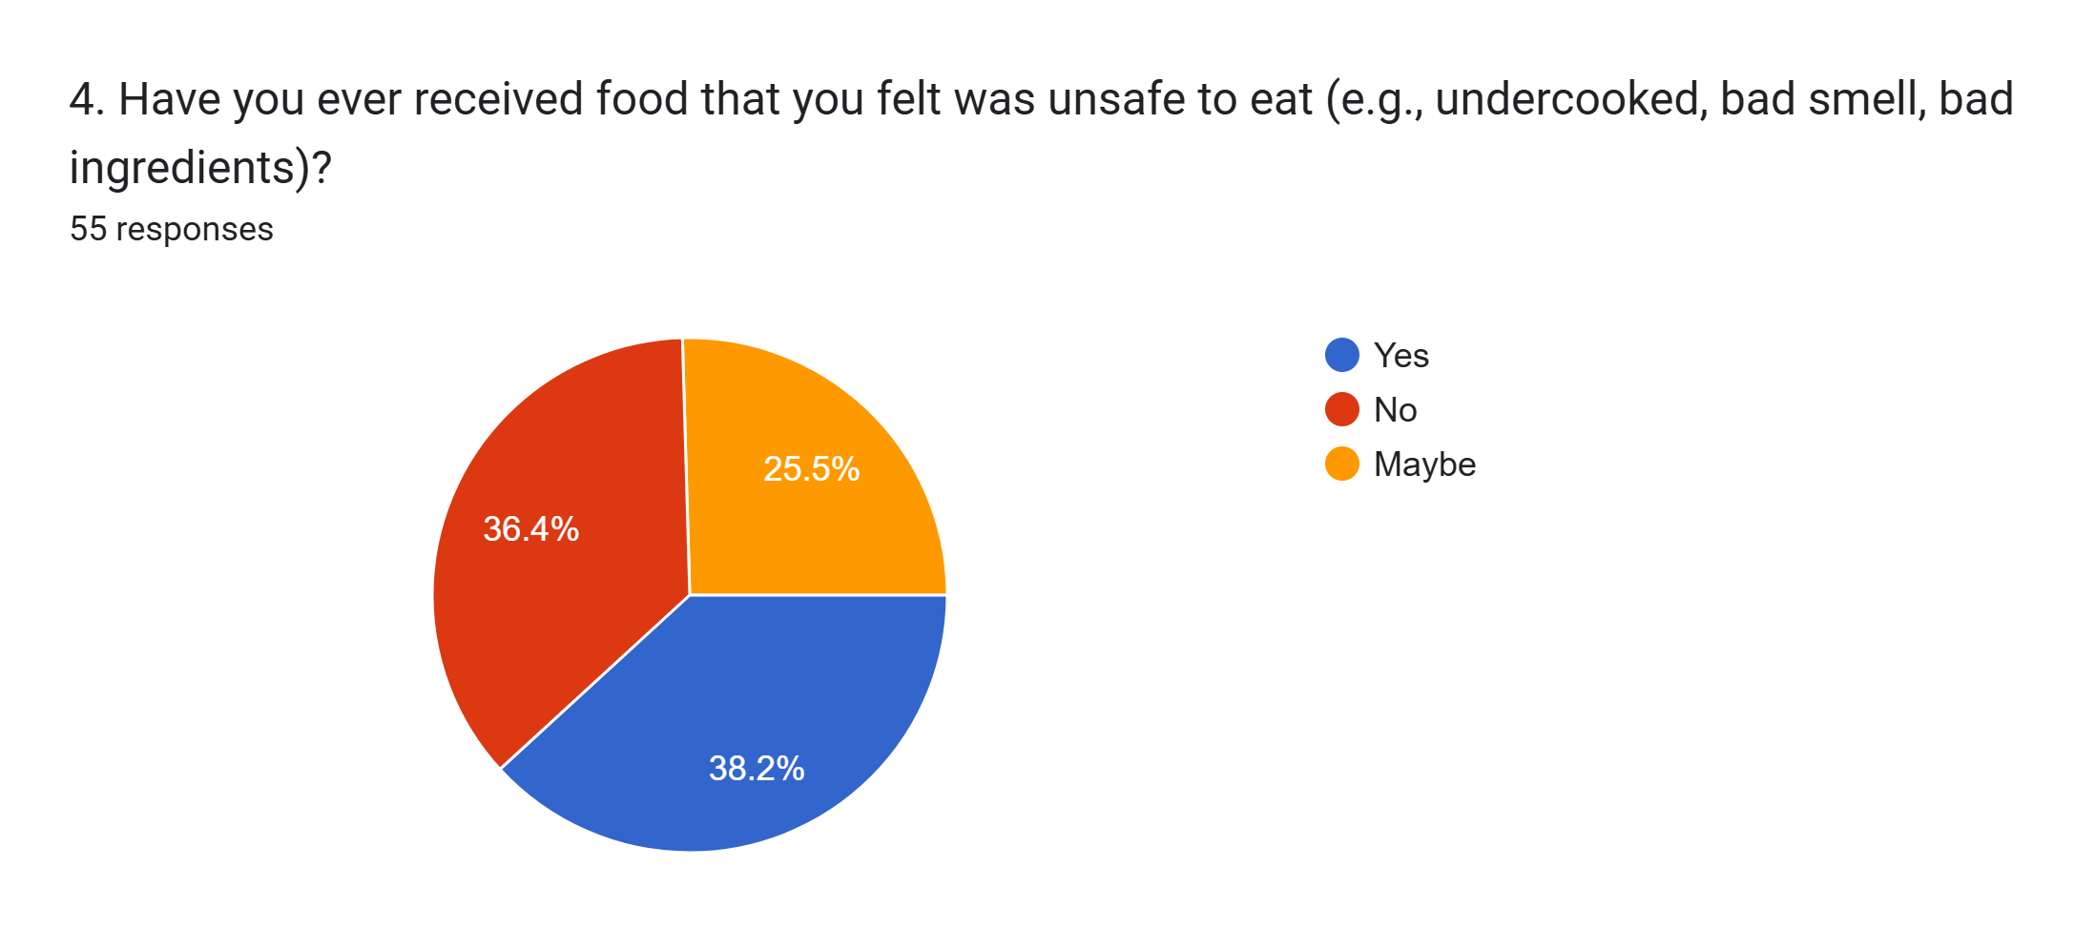
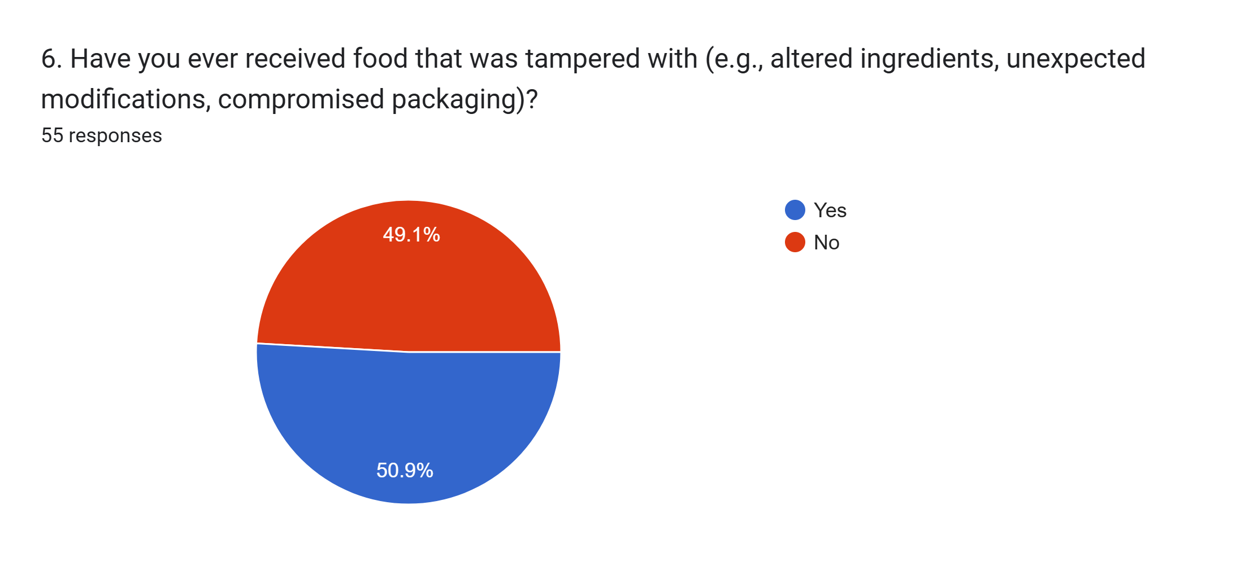

Slide 5
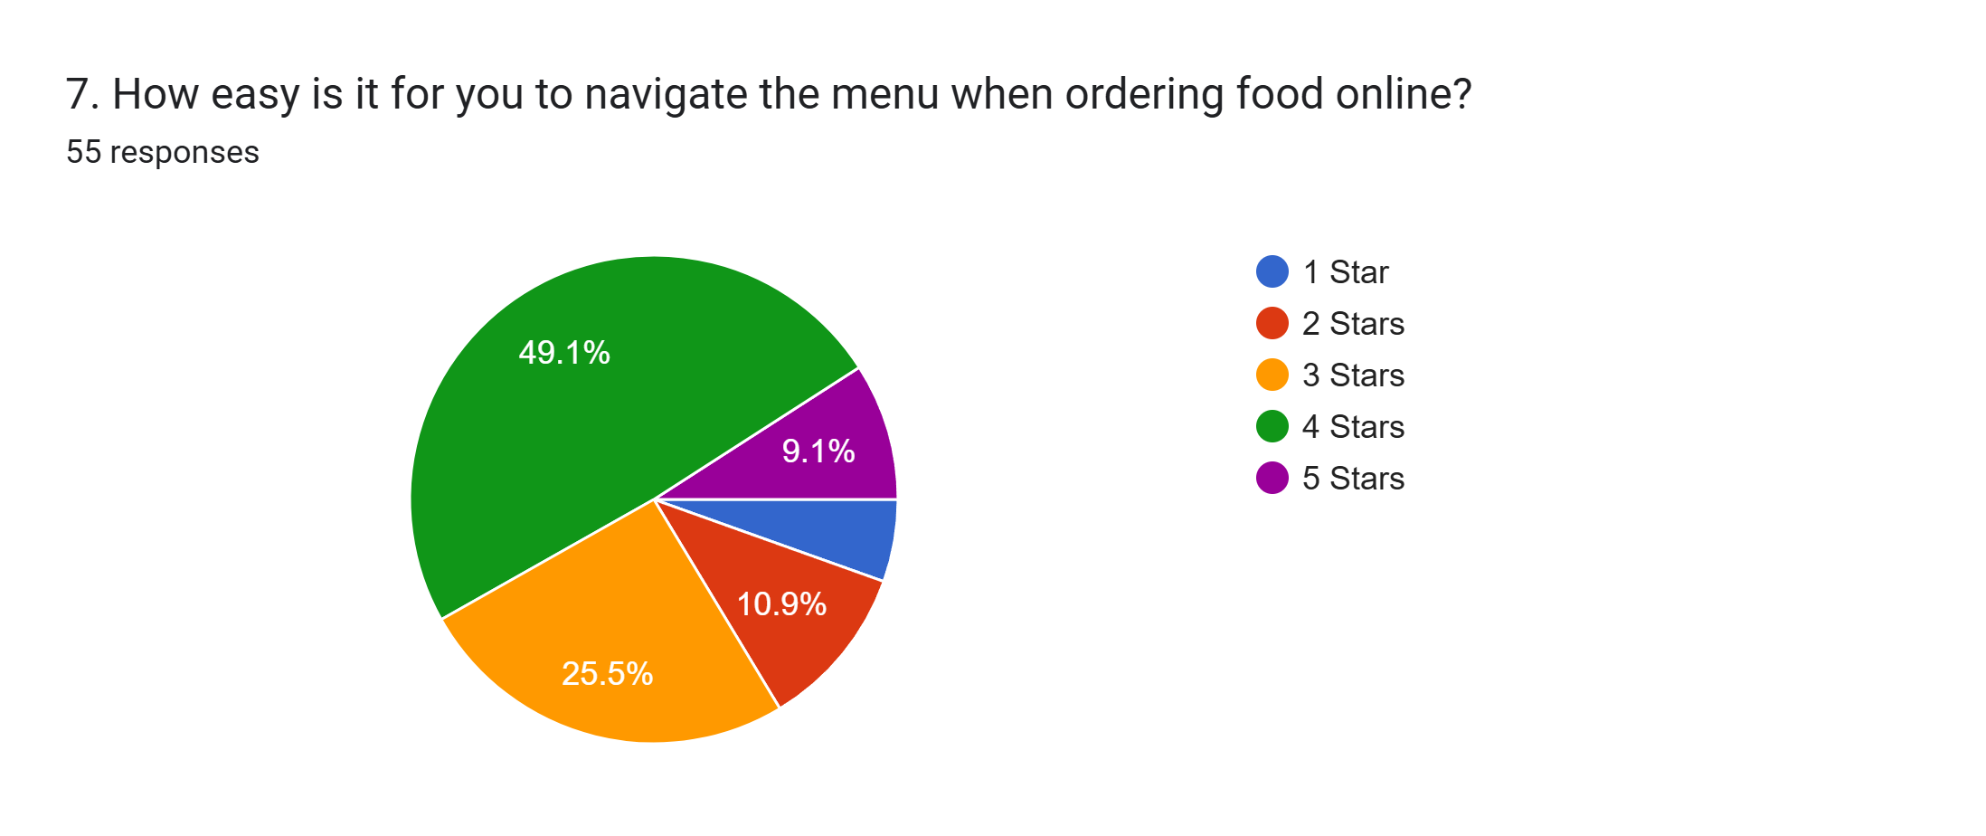
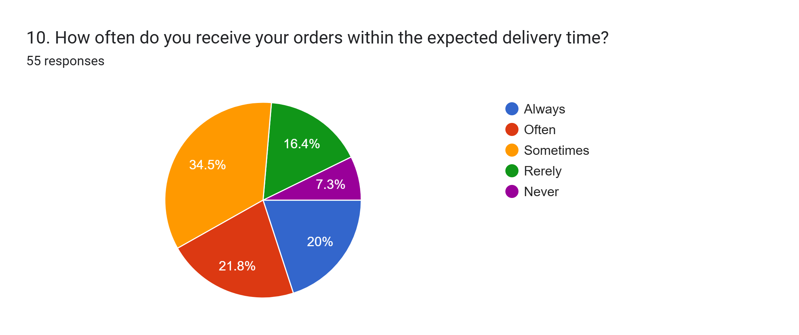
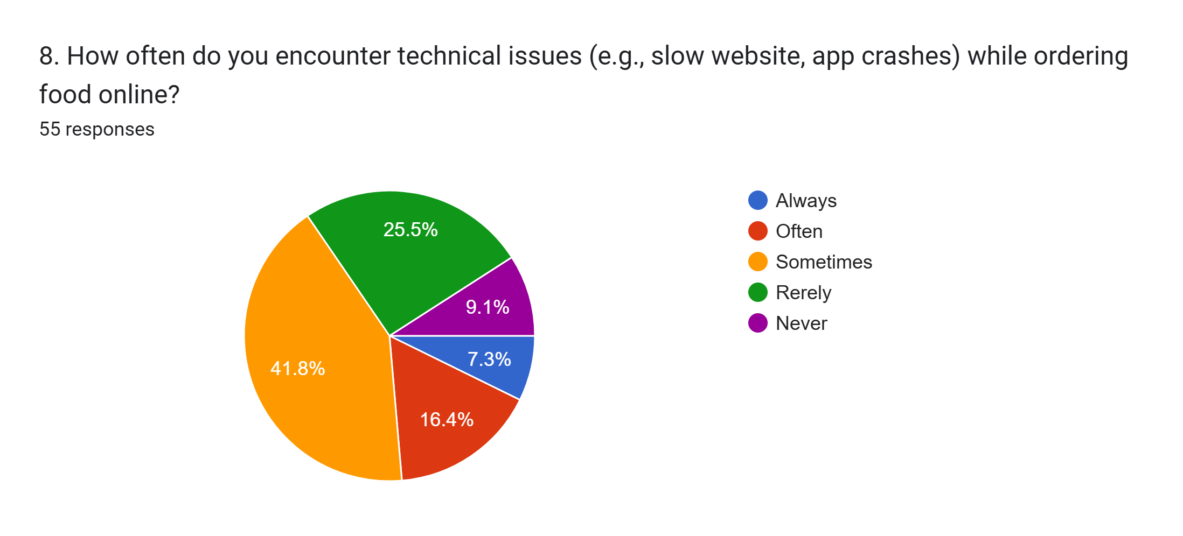
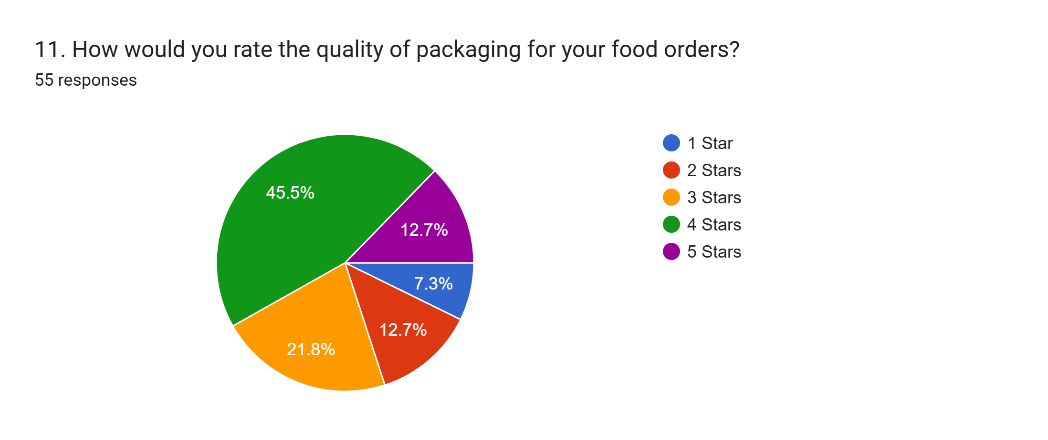

Slide 6
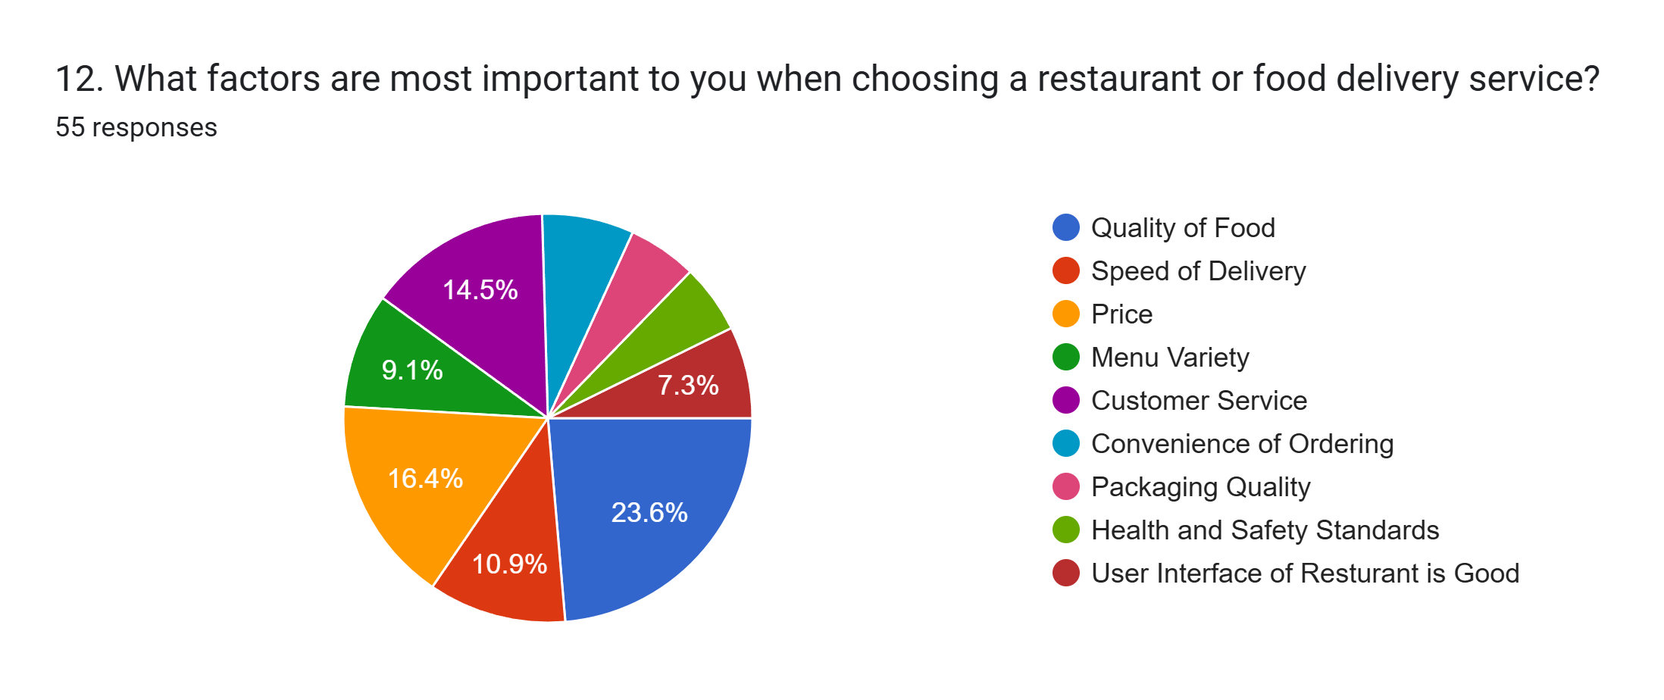
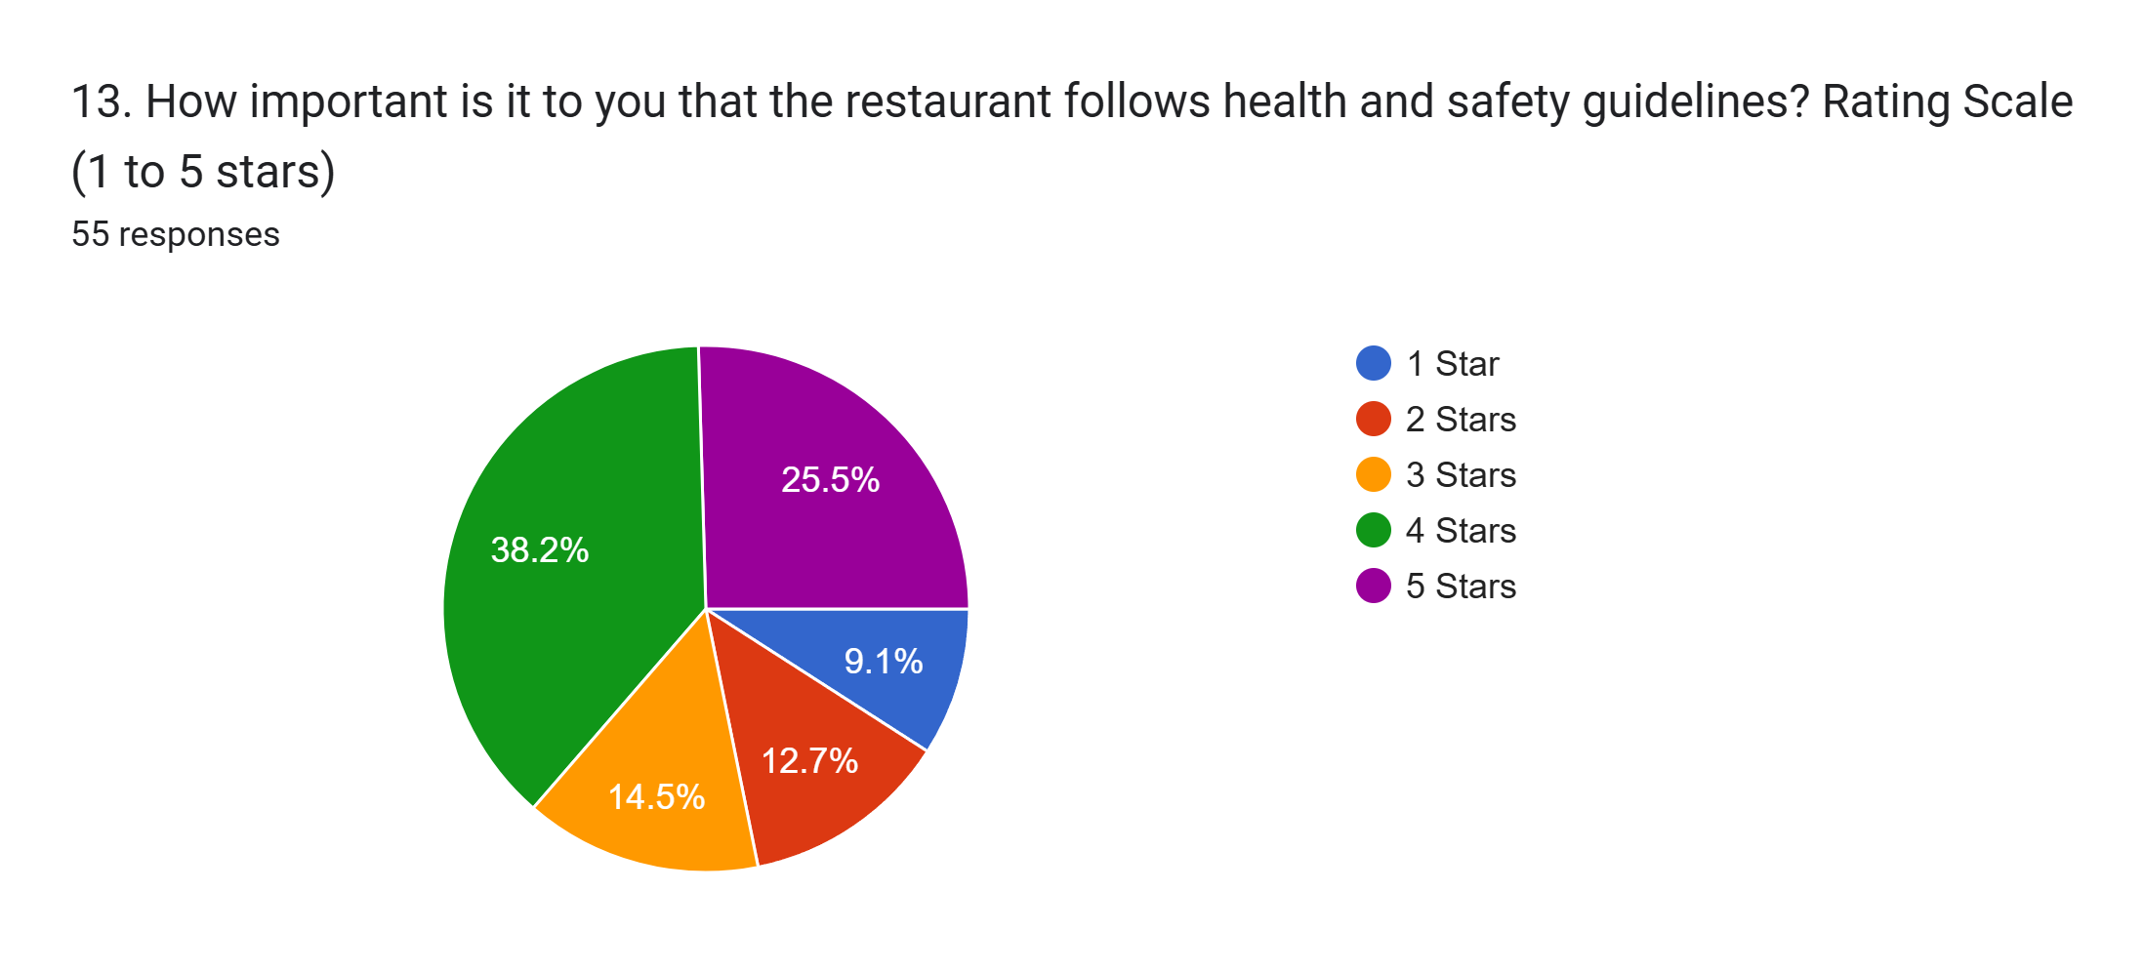
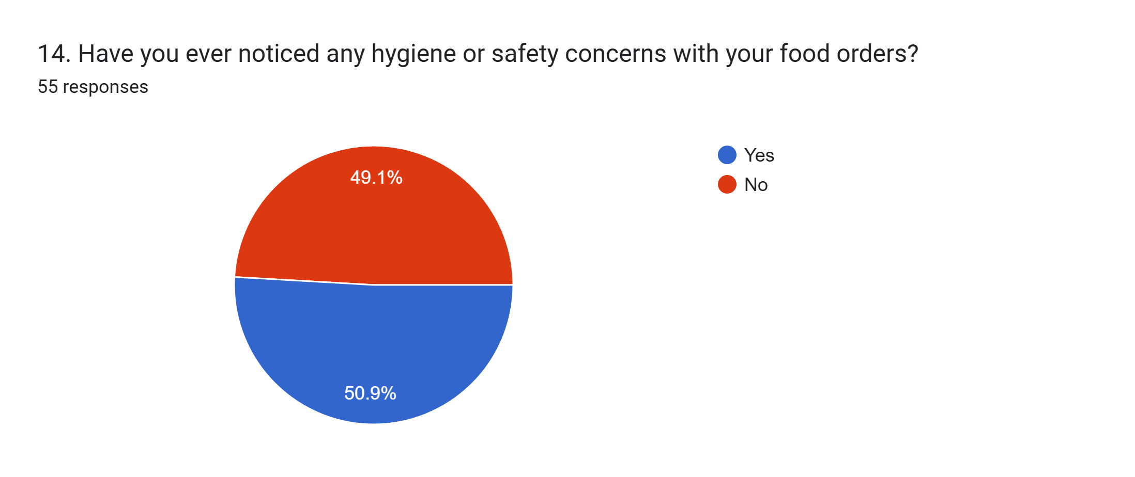
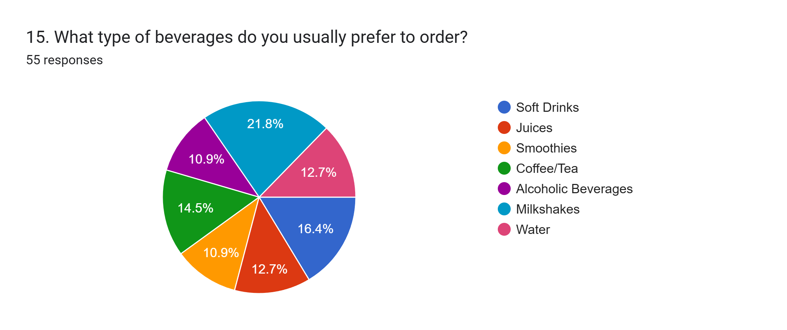

Slide 7
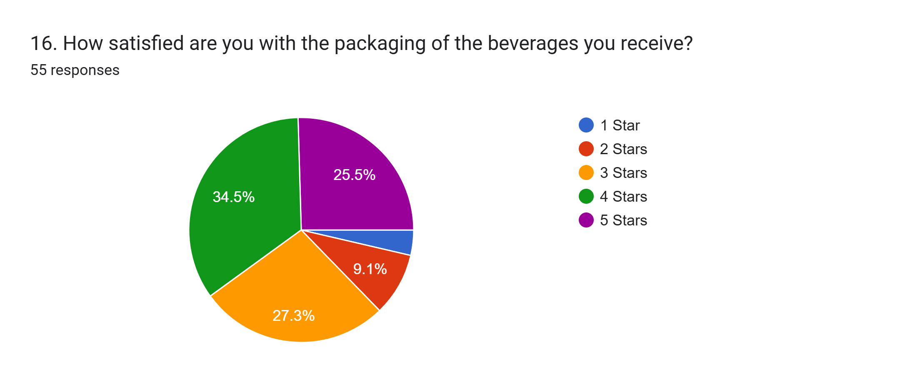
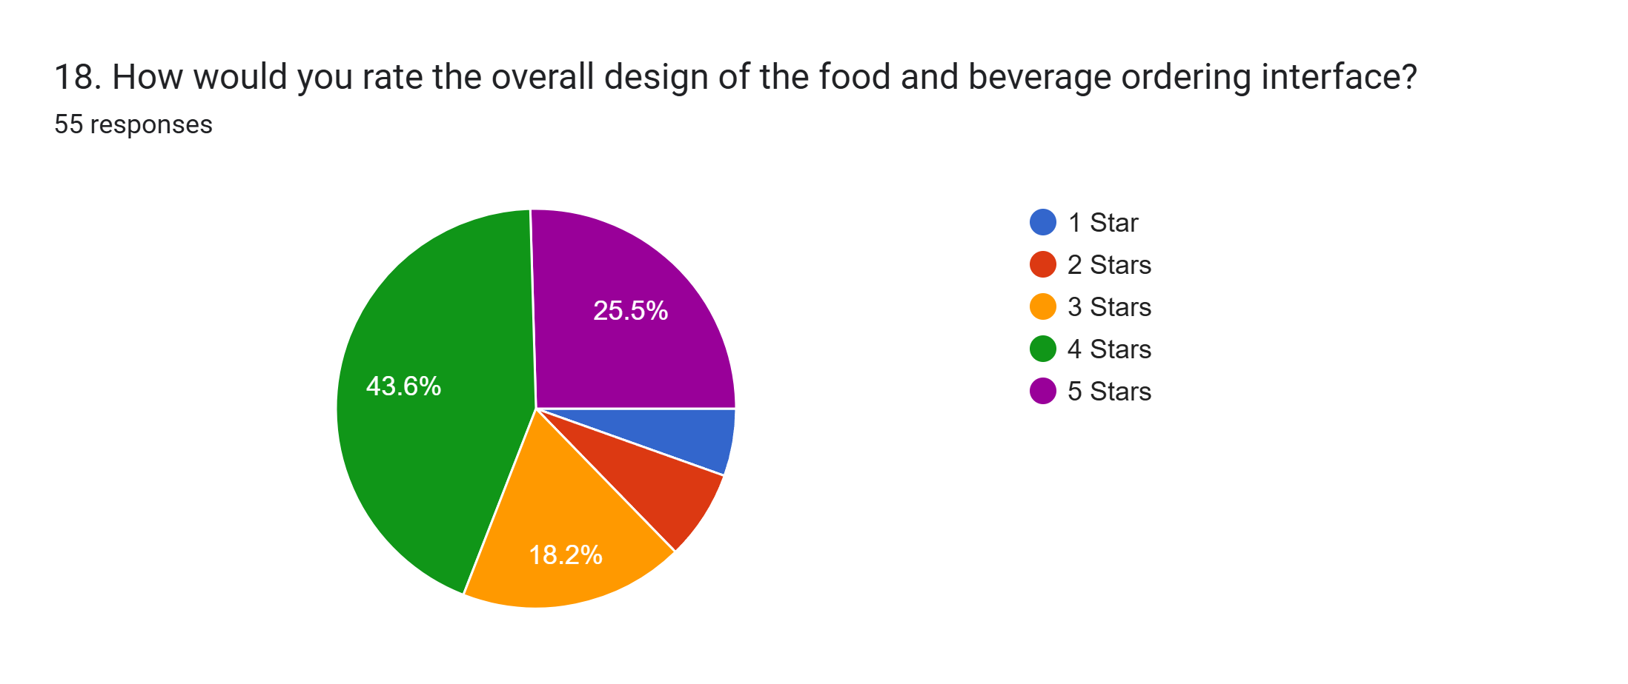
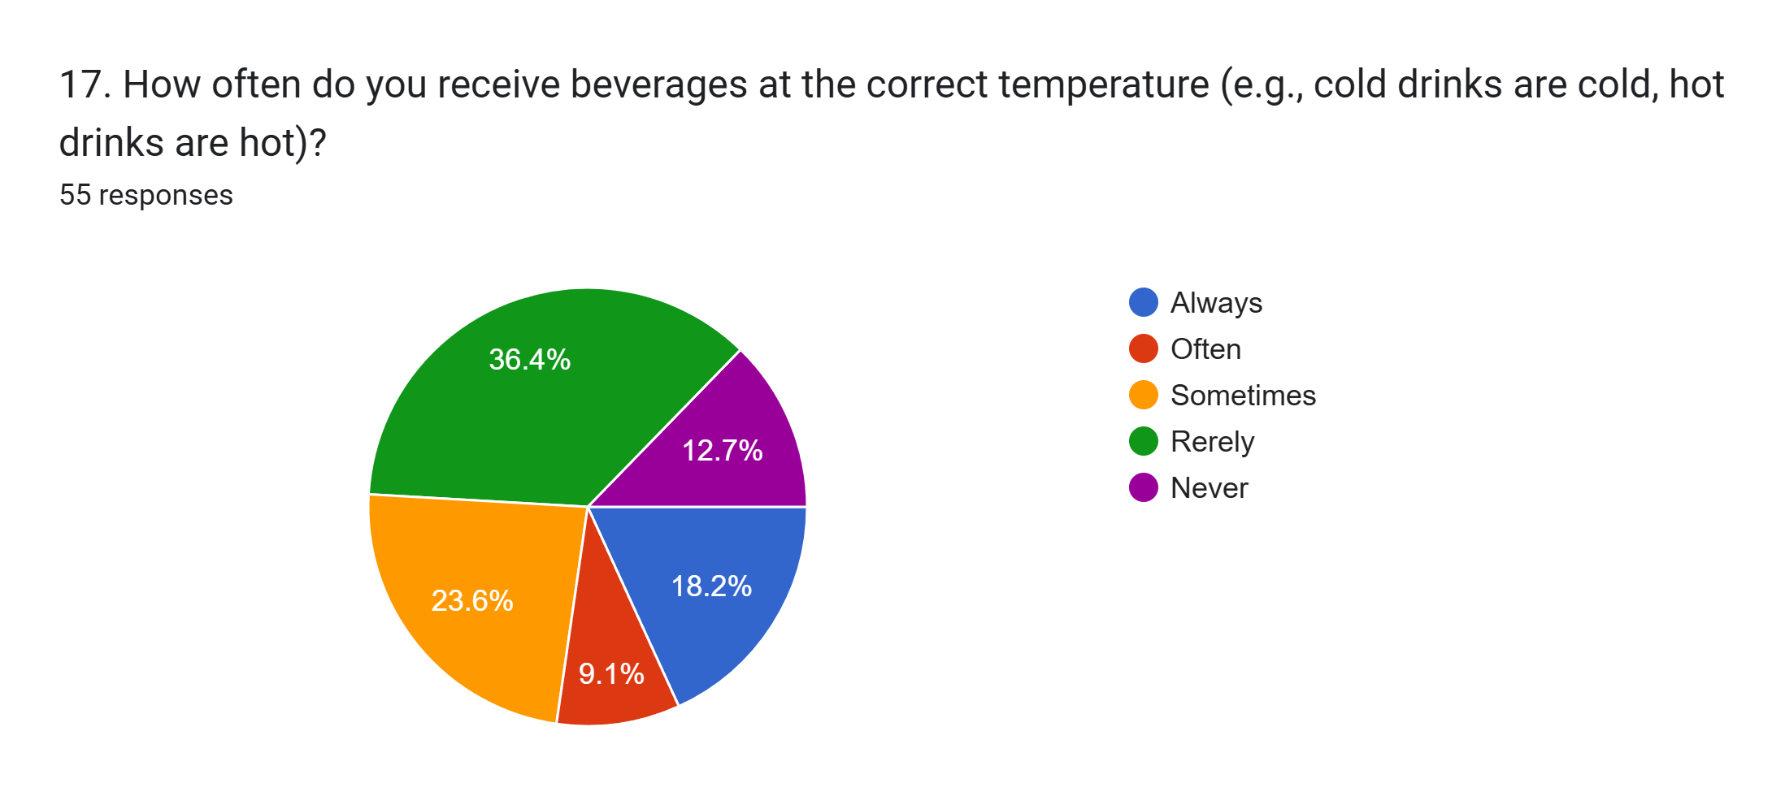
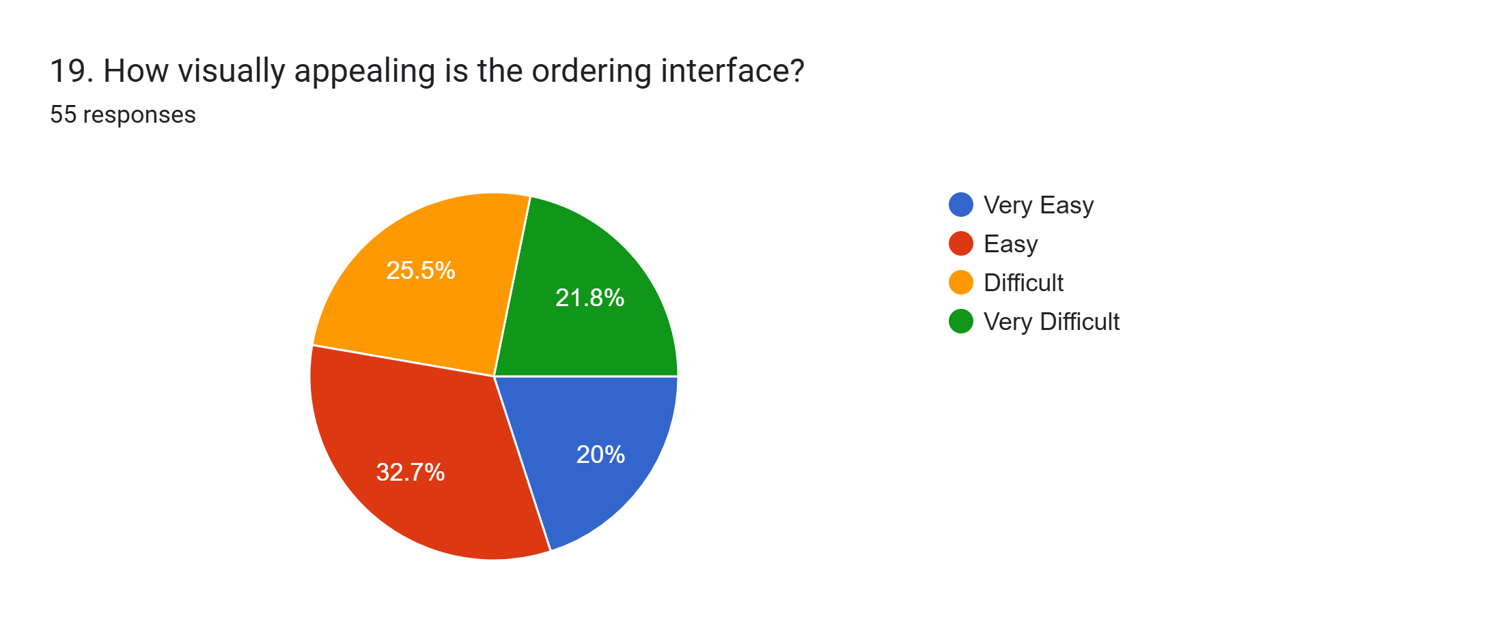
LINK :
https://docs.google.com/forms/d/e/1FAIpQLSc6HdLBiFzs4vuUtUiuoTB6qG8RLaLx19rJOpKvRJrRqfAS5A/viewform?usp=sf_link

Slide 8
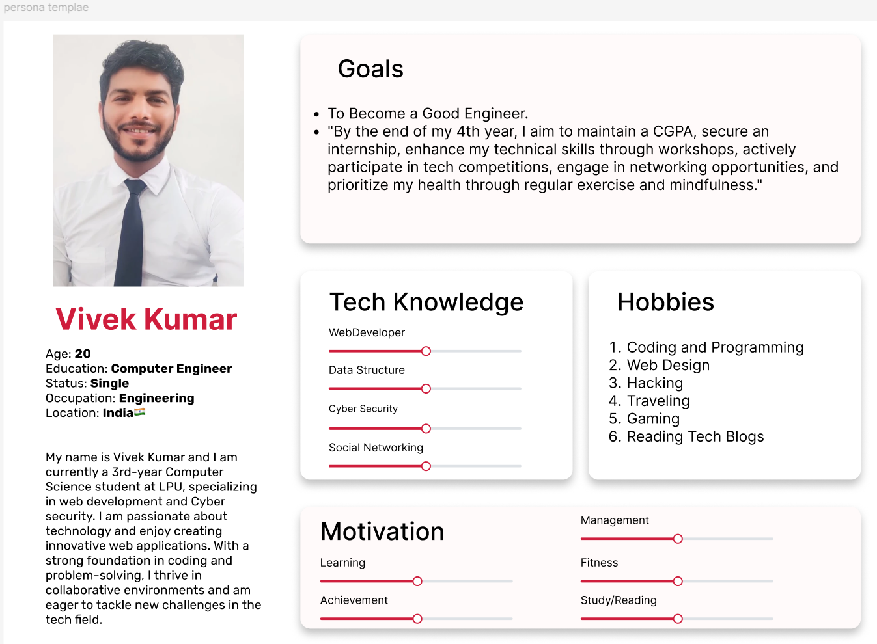
USER USER PERSONA PERSONA
OF VIVEK KUMAR

Slide 9
User Persona
Link in Figma :
https://www.figma.com/design/Zr8iz18KcZ9vQi9u5WVWP0/Vivekkumar-gupta-User-Persona-template?m=auto&t=ctrtOAuIxYAgf0y2-6

Slide 10
Empathy Mapping
"I can't afford to waste time waiting for my order updates”
"I want clear and detailed information about meals, including ingredients and pricing, to make better decisions..“
"If the site is slow, I’ll go to another site"
" I need to be sure the food matches its description and looks appetizing."
"High-quality images will enable me to accurately identify the product I am purchasing."
" I want a smooth, hassle-free ordering experience without wasting time."
Says Thinks
Shailesh
Does
It’s frustrating when the app takes too long to load or lacks essential details about the food items.
Explores different meal options and reviews to find the best one.
Feels
.
However, with clear descriptions, high-quality images, and honest customer reviews, users feel confident about their orders.
Carefully reads the customer's reviews before I purchase it.
Without sufficient information, users may waste time dealing with incorrect orders or unsatisfactory meals, leading to a poor experience.
Abandons the app if it's slow or lacks clear food descriptions and prices.

Slide 11
Empathy Mapping
"Give me a site that’s very fast one and {"that"} at the same time gives me information clearly without making me search each part."
"I can’t be bothered with slow-loading websites."
"I should be ensured that my spending is worth."
"A slow site which doesn’t give me the information I want, may take longer than usual and prevent me from doing things that are more important."
"Do they constitute the food products that are reliable and worth the investment?"
"The use of high definition images and customer reviews is indispensable for being well-informed."
Says Thinks
Prem
Does
He shops for the items Needed to buy for your business inventory as well as your personal needs over the web, which is very necessary for him, if he wants to have both effective and reliable shopping.
Feels
Furiated when a website is slow or does not adequately offer the product details that are required.
Happy only when he can see the high-quality food images, detailed descriptions, and customer reviews and if there is also the shopping part.
He compares the products and rates them for their features and the availability of the descriptive image including customer reviews of multiple items.
Relieved when he feels the food Delivery process is very fast, which is smooth, and when he can get exactly what he has ordered.

Slide 12
CA-2
Understanding User Flow Diagrams
User Flow Diagrams: User flow diagrams are visual tools used to map out the steps a user takes to complete a specific task within an application or website. They help in understanding the user's journey from the initial entry point to the final goal. Key components include:
Entry Points: Starting locations like the homepage or login page.
Steps/Actions: The sequence of interactions, such as navigating through forms or clicking buttons.
Decision Points: Moments where users make choices that affect their path, such as selecting payment options.
End Points: The final outcomes like a successful purchase or account creation.
Benefits: →
Clarity: Provides a clear visualization of user journeys and interactions.
Efficiency: Identifies potential bottlenecks and areas for improvement.
Alignment: Ensures team members have a shared understanding of user pathways.

Slide 13
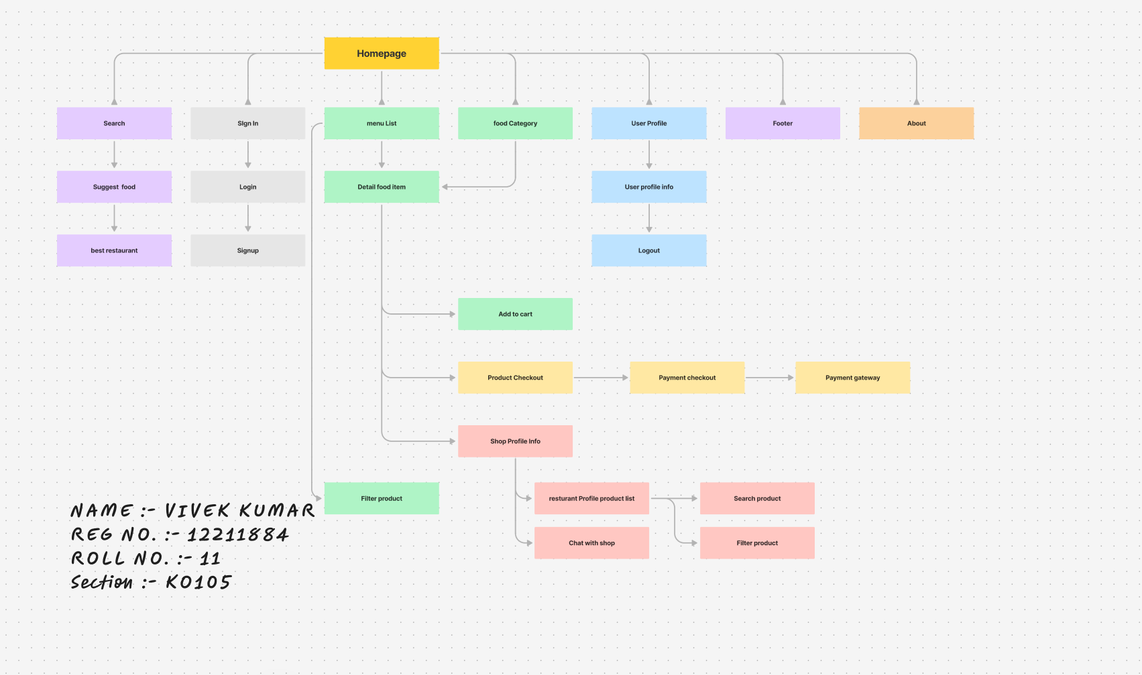
Information Architecture & Indexation
Information Architecture & Indexation - online food dilivery12207821 – FigJam

Slide 14
Understanding Information Architecture
Information Architecture (IA): Information architecture is the structural design of information environments. It organizes and labels content to help users find information and complete tasks efficiently. Core elements include:
Content Inventory: A comprehensive list of all content types and their relationships.
Sitemaps: Diagrams showing the hierarchical structure of the site.
Wireframes: Basic layouts of page elements to illustrate content placement.
Navigation Systems: Tools like menus and search functions that aid in content discovery.
Benefits: →
User Experience: Enhances usability by making navigation intuitive and content accessible.
Consistency: Maintains a coherent structure across different sections of a product.
Scalability: Simplifies updates and expansion as new content is added.

Slide 15
USER FLOW DIAGRAM :
LINK OF FIGMA :
https://www.figma.com/board/HGWszLbQUr7XncRJ4g4QLC/UserflowDiagramvivekkumar12211884CA-2?t=3v855Yo6LL0rheFZ-6
INFORMATION & ARTITECTURE DIAGRAM
LINK OF FIGMA :
https://www.figma.com/board/q90IAc7E81q5LVlgQNUvnM/Information-Architecture-%26-Indexation---online-food-dilivery12211884?t=3v855Yo6LL0rheFZ-6

Slide 16
CA-3
INTRODUCTION
As food delivery services on campus grow, creating a user-friendly experience is crucial for students and staff. Common challenges—such as complicated navigation, unclear delivery tracking, and lack of personalization—can frustrate users and delay their food orders.
Low-fidelity wireframes help address these issues by allowing designers to visualize the app's structure and functionality early in the process. By focusing on essential elements like simplified navigation, real-time delivery tracking, and mobile optimization, these wireframes aim to enhance the food delivery experience. This foundational step will help create a more efficient and user-friendly platform that meets the needs of campus life.

Slide 17
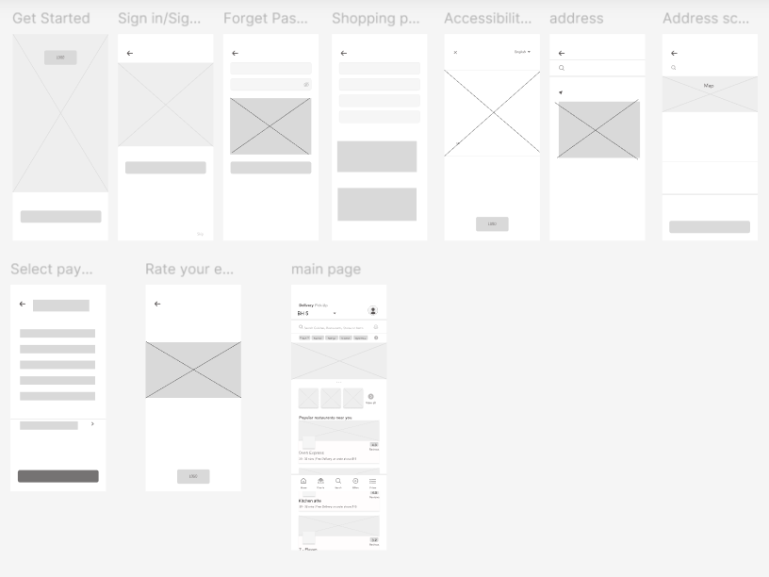

Slide 18
CA – 3 –Figma Link
https://www.figma.com/design/BQ5calKpixnxLvvHTD4C5O/UI-UX-CA-3-vivek-kumar?m=auto&t=7VYDqznxNtOLCXr4-6

Slide 19
CA - 4
INTRODUCTION
High-fidelity wireframes are essential for designing a seamless food delivery app for the LPU campus. They provide a detailed visualization of the app, incorporating branding elements, interactive features, and optimized layouts. Clear navigation menus and food categories ensure users can easily browse options, while high-resolution images showcase meals attractively. Mobile responsiveness is prioritized with tap-friendly buttons and smooth scrolling, ensuring a seamless experience on any device. Real-time order tracking and delivery updates are clearly visible for user convenience. Performance is visualized through dynamic loading indicators and optimized content. User reviews, meal descriptions, and prices are clearly presented to help users make informed decisions. The wireframes also emphasize visual hierarchy, ensuring promotions and popular meals stand out. By enabling testing and refinement, these wireframes lay the foundation for an efficient, user-friendly food delivery platform.

Slide 20
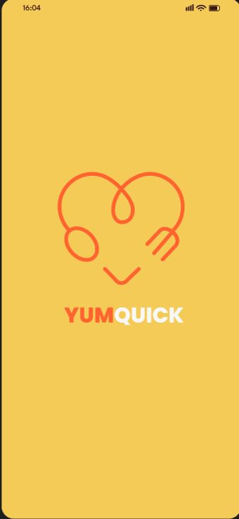
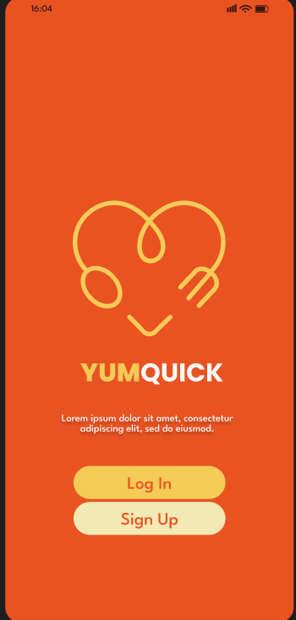
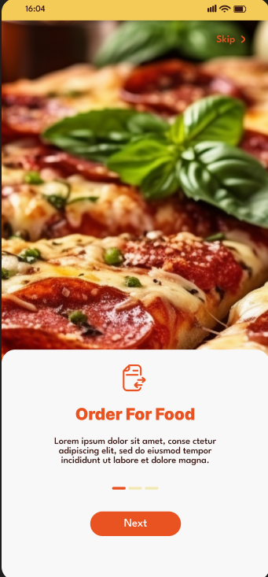
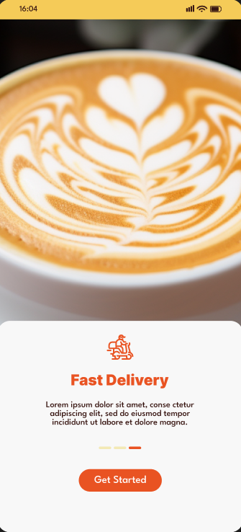

Slide 21
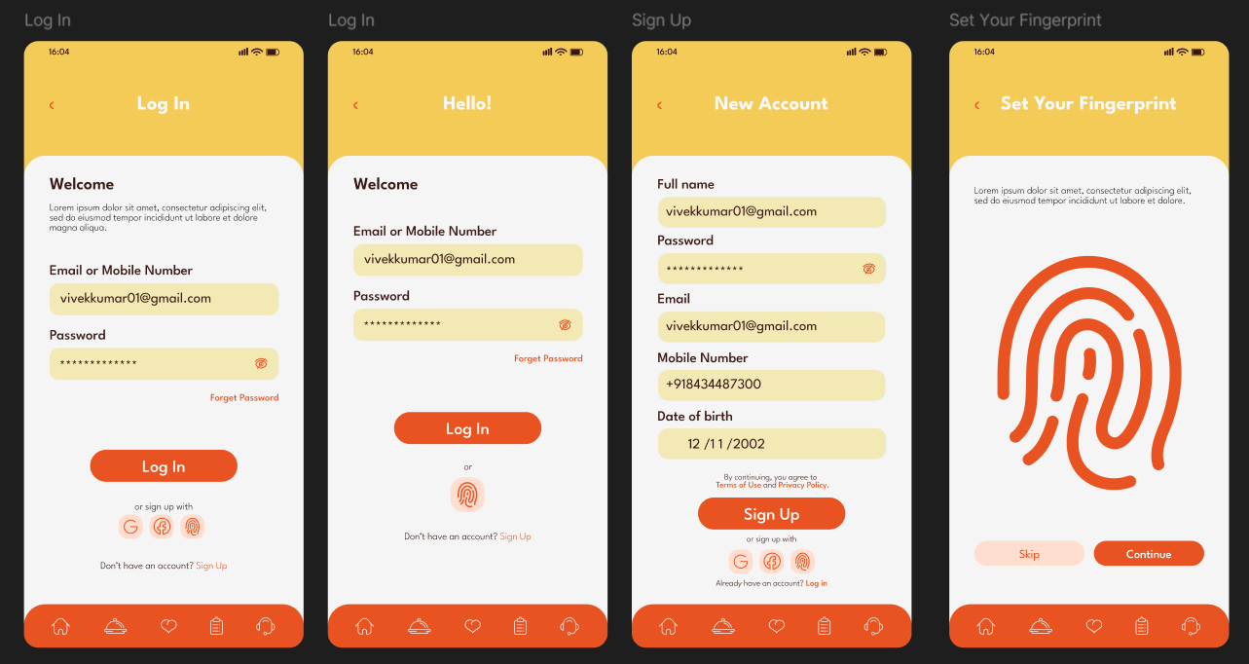

Slide 22
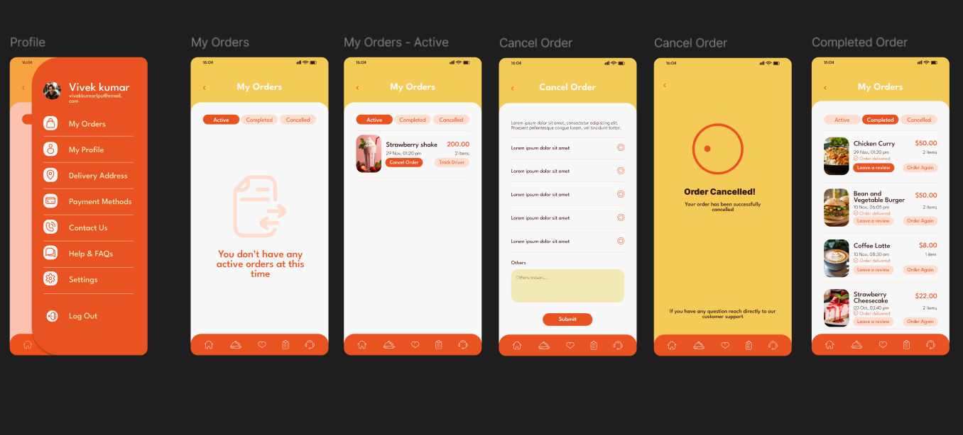

Slide 23
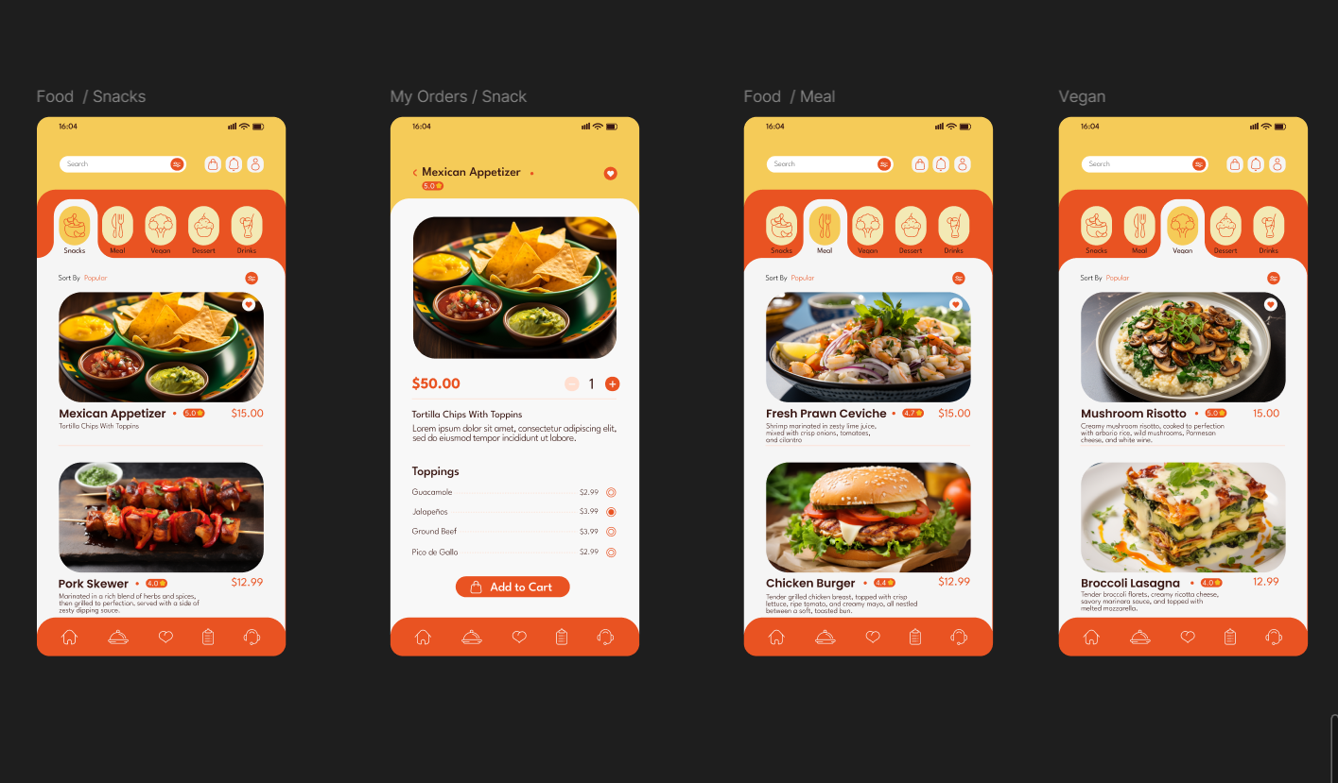

Slide 24
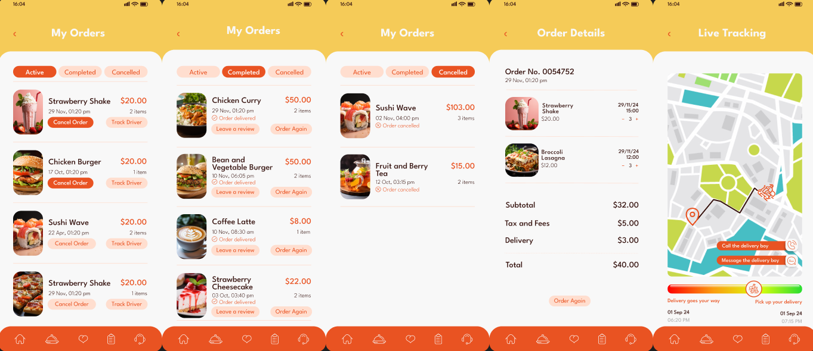

Slide 25
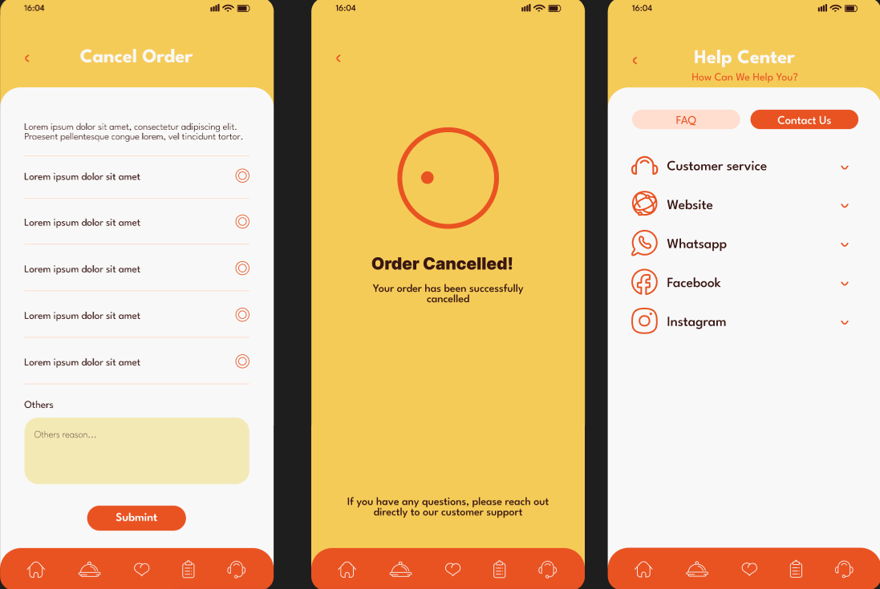

Slide 26
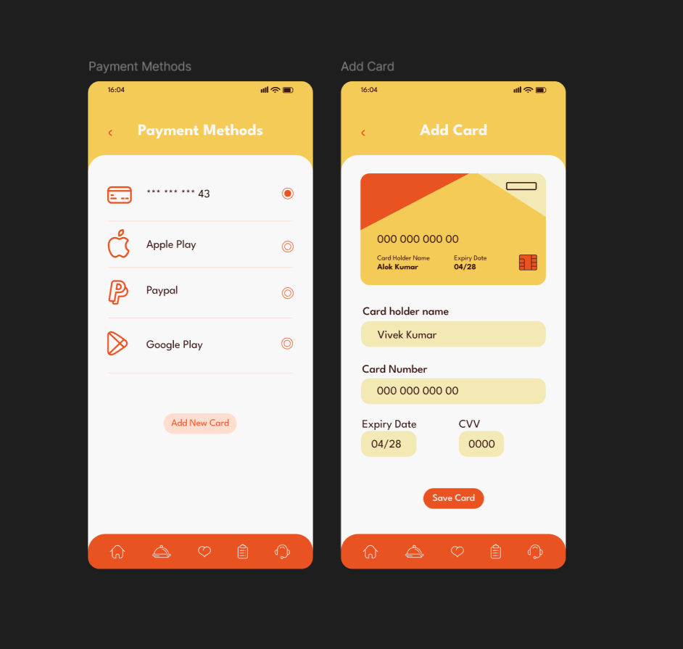
https://www.figma.com/design/YxzqnT2aQBRNTTAifUV68i/UI-UX--Final-CA-4-Vivek-kumar?m=auto&t=7VYDqznxNtOLCXr4-6

Slide 27
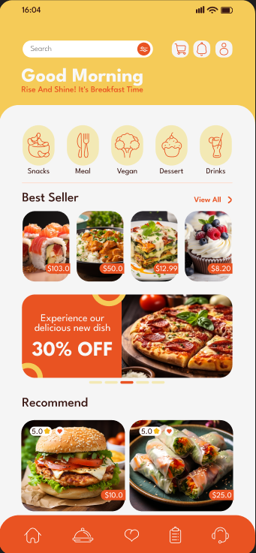
Home View
At LPU Food Delivery App, we’re more than just a food ordering platform; we’re your personal campus delivery service designed to provide a seamless and enjoyable dining experience. From snacks and beverages to full meals, we offer a curated selection of high-quality food options that suit all your cravings, delivered straight to your hostel or anywhere on campus.

Slide 28
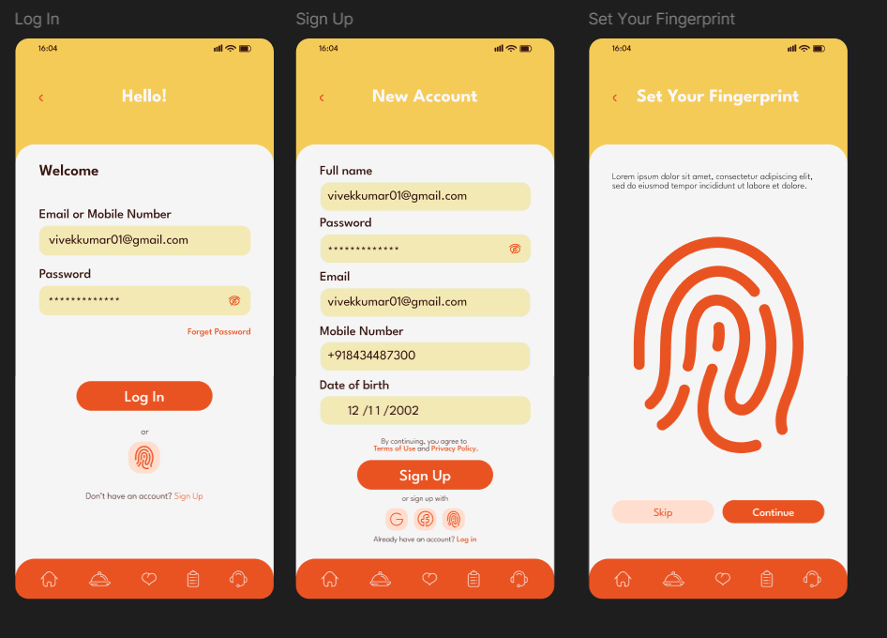
Login & Sign Up
Our shopping website offers a secure and user-friendly login and signup system. Users can
log in quickly with their email or mobile num-
ber, while new users can sign up with basic details or via Google for convenience. Features like "Forgot Password" and password strength indicators ensure security and ease of access. Both pages are optimized for mobile and
desktop for a seamless experience.

Slide 29
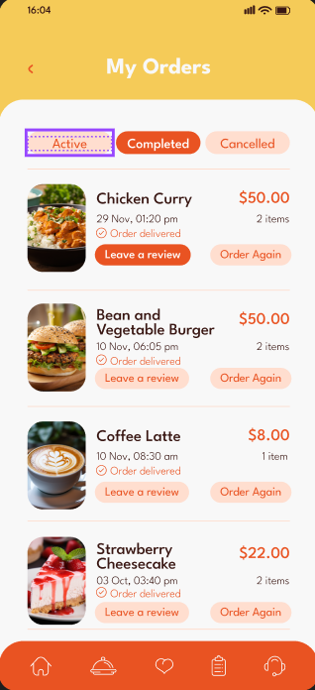
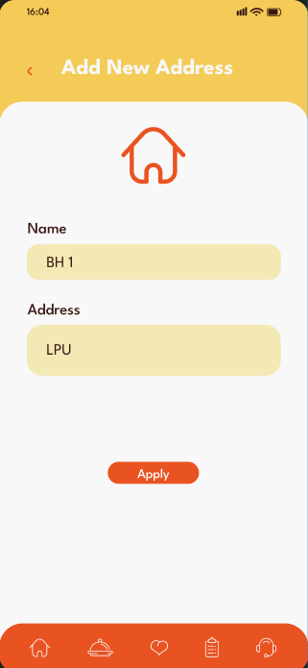
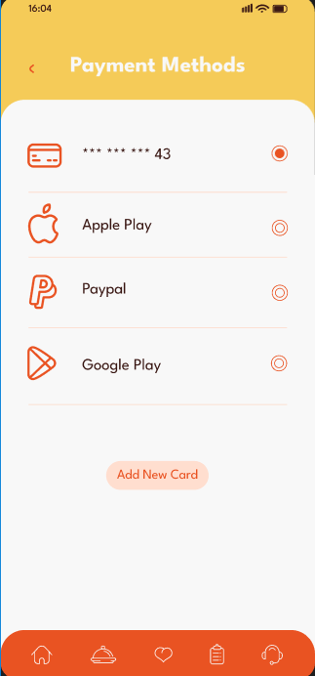
Order Details
Payment Method
Address Details

Slide 30
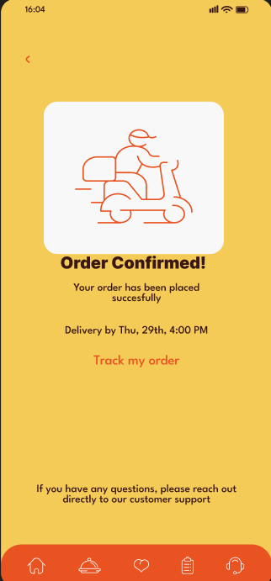
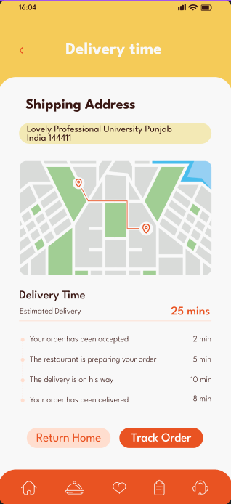
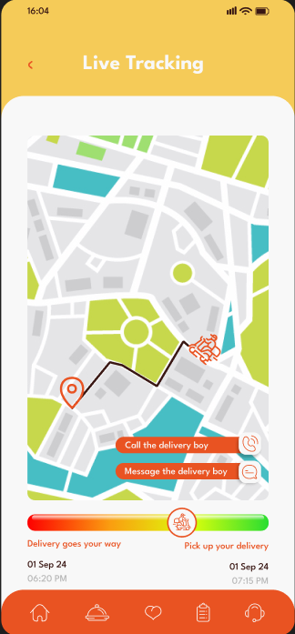
Order Tracking Details Track your food delivery in real-time:
Order Status: See if your food is being prepared or on its way.
Delivery Progress: Check the estimated delivery time and location.
Notifications: Get updates when your order is confirmed, dispatched, and near.
Delivery Confirmation: Know when your order is delivered.

Slide 31
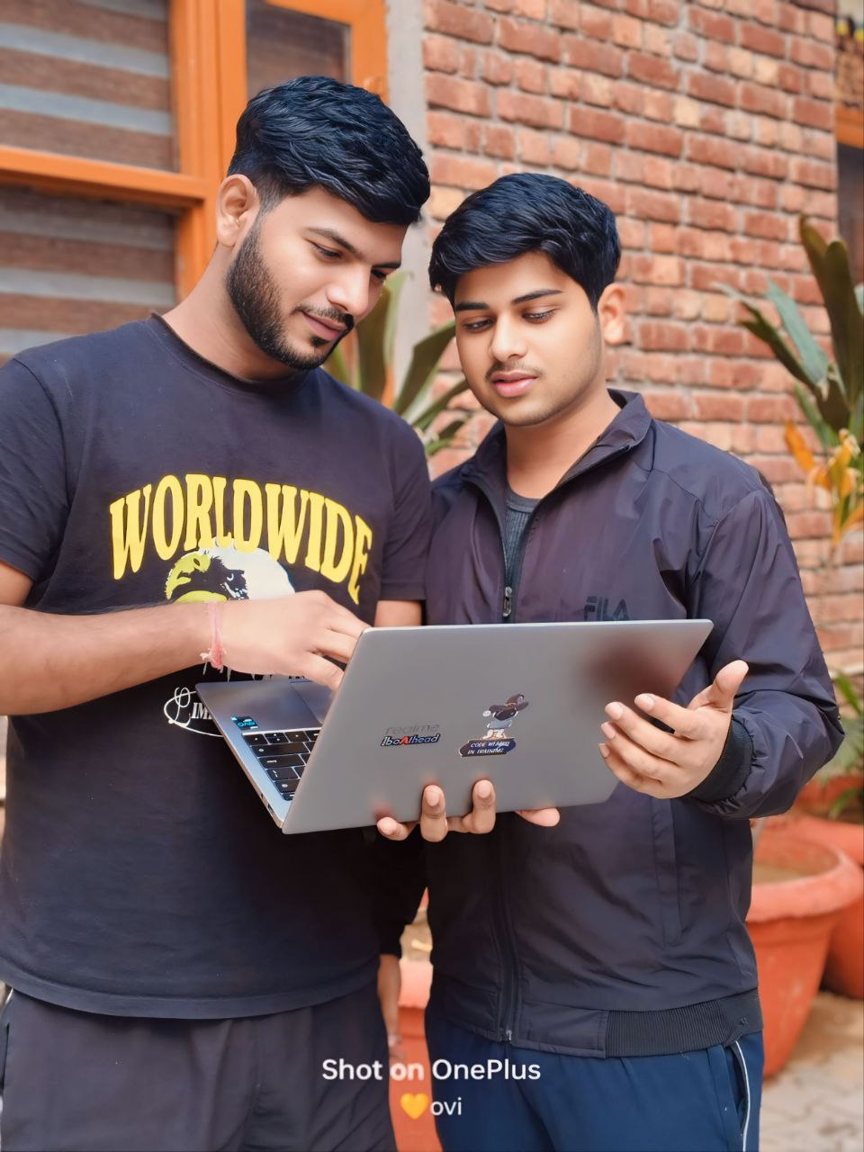
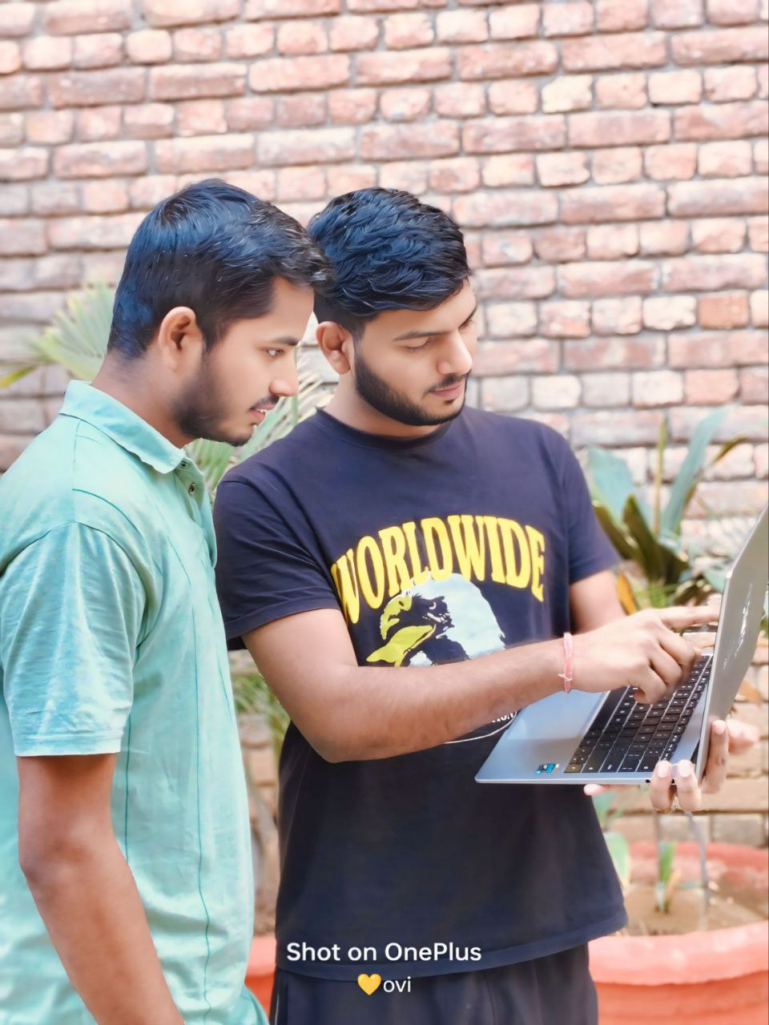
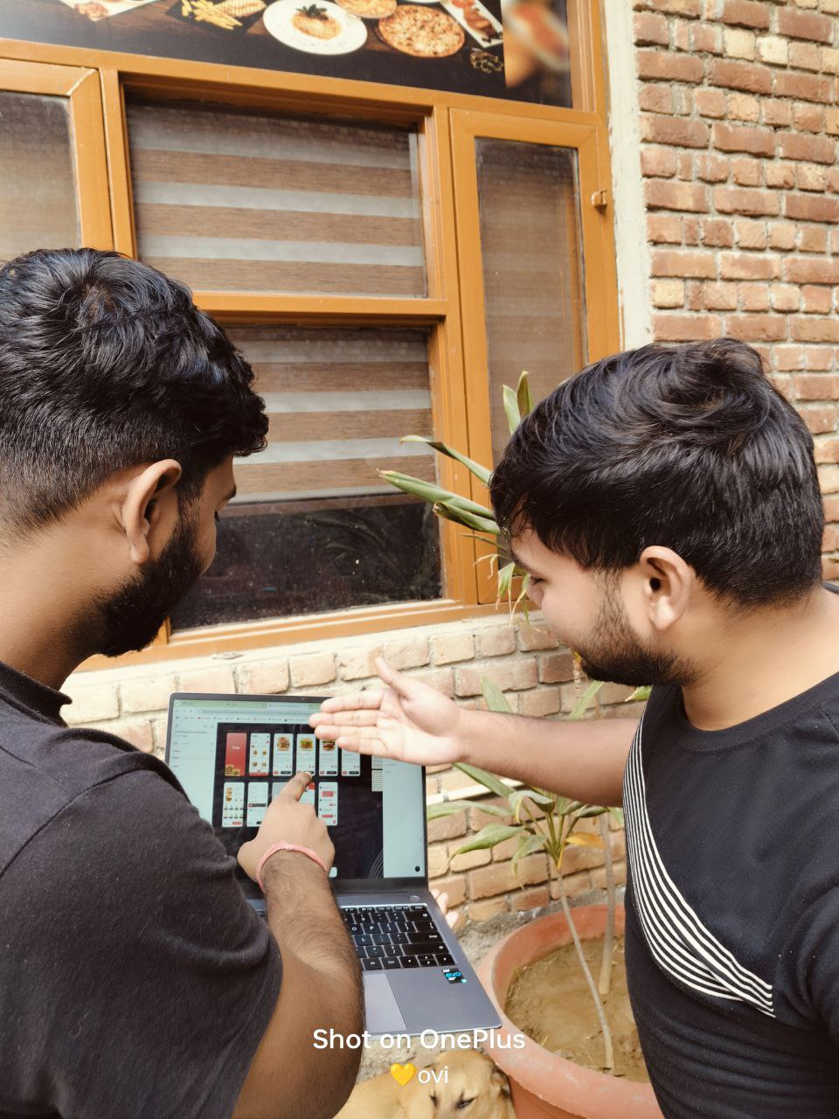
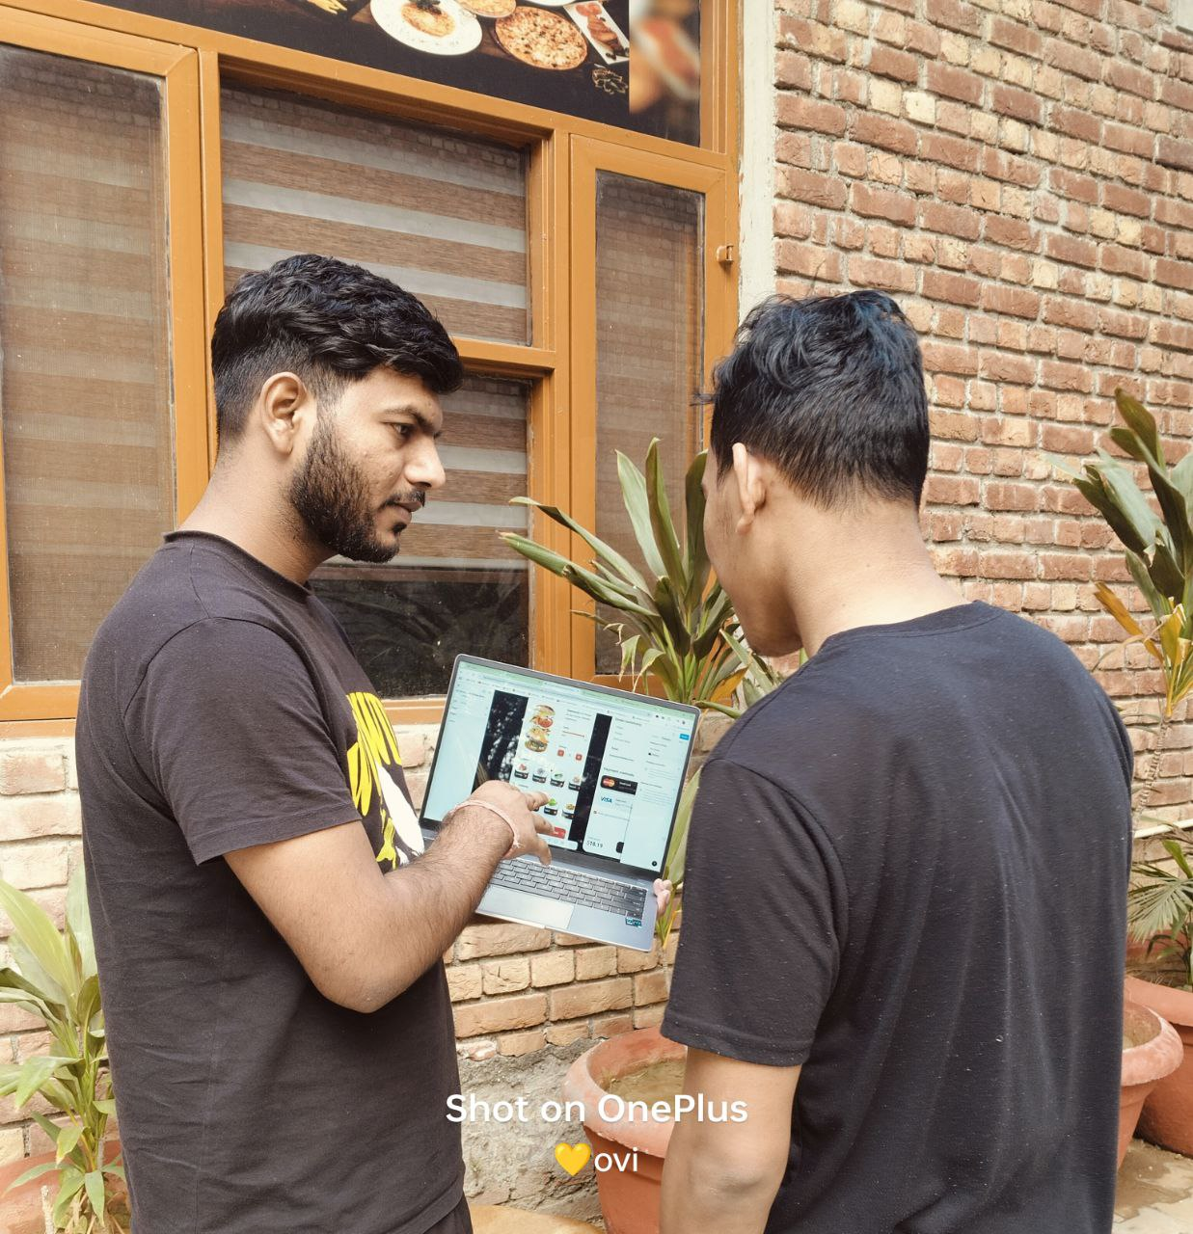
Taking Review for High Fidlity wireframe with Others Students

Slide 32
THANKYOU

